Slide 1

TASK-231012
SynchroniTask: Fostering team Harmony and Turbocharging Productivity
SHASHANK MAHATO
SUBHASHINI.S.M
DHARUNI.M

Slide 2
TASK-231012
OVERVIEW
Problem statement
Design & Develop an intelligent task management system that leverages the concepts like AI, ML, Data Analytics and User Friendly Interface
Proposed solution
SynchroniTask" revolutionizes task management and collaboration by leveraging a unique combination of gamification, real-time emotion analysis, AI-driven task feedback, and collaborative decision support. It redefines the traditional task allocation process, infusing it with gamified elements to boost motivation and engagement among team members. Real-time emotion analysis ensures that emotional well-being is taken into account, reducing stress and fostering a more harmonious work environment. AI-driven task feedback enhances efficiency, leading to increased productivity. Collaborative decision support is the secret sauce that enables informed, consensus-driven choices. Together, these elements orchestrate a symphony of harmonious task management and emotional well-being, resulting in an efficient and captivating work environment that rejuvenates teamwork and productivity. "SynchroniTask" is a true game-changer in the realm of task management and collaboration.

Slide 3
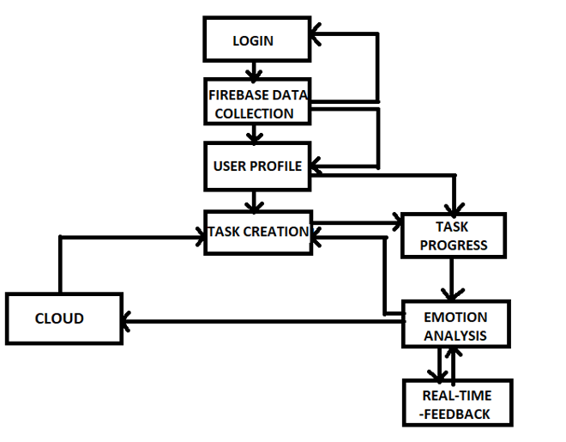
TASK-231012
Architecture/Flowchart

Slide 4
TASK-231012
Dataset:
https://www.kaggle.com/datasets/abhi8923shriv/sentiment-analysis-dataset
Gradient boosting and Task prioritization-Reinforcement Learning (Dueling DQN): Excels in structured data by combining weak learners for predictive accuracy, while Dueling DQN with task prioritization optimizes reinforcement learning training efficiency and prioritizes task selection in complex environments.
NLP - Natural Language Processing & Deep Learning Model - XLNet: Complex text data and requires state-of-the-art language understanding and sentiment analysis capabilities.
Dialogflow (Google): Ease of integration with other Google services, robust natural language processing capabilities and strong support for multilingual and cross-platform deployment.
Frontend:
React.js
HTML/CSS-Benefit from its component-based structure, efficient updates, and extensive ecosystem, ensuring responsive, cross-platform web applications.
Backend:
Node.js- non-blocking, event-driven architecture, a vast library of packages from npm, and the ability to use JavaScript both on the frontend and backend, enabling full-stack development with consistent language.
Database:
Firebase-real-time data synchronization, serverless architecture, built-in authentication, and easy scalability, simplifying backend development and allowing rapid prototyping of web and mobile applications.

Slide 5
TASK-231012
Limitations or challenges:
1. Emotion Recognition Precision:
-Recognizing nuanced emotions accurately in real-world scenarios can be challenging due to the subjectivity and variability in human emotions. Achieving high precision in all cases may still be a work in progress.
2. Data Privacy and Security Assurance:
-While encryption and intrusion detection are essential, data security is an ongoing concern. Even with robust security measures, there is no guarantee against all possible security threats, and vulnerabilities can emerge over time.
3. Complex System Integration:
-Integrating with diverse systems can be complex and may require ongoing maintenance. Compatibility issues, changes in external APIs, and updates to data structures can pose challenges.
4. Efficacy of Training and Education:
- While advanced pedagogical models and adaptive learning algorithms are valuable, the effectiveness of education also depends on various factors, including the quality of content and the engagement of learners. Individual differences and external factors can impact learning outcomes.
5. Real-Time Analysis Speed:
- Achieving real-time analysis speed is influenced by factors such as the volume of data, hardware limitations, and the complexity of algorithms. Extremely high data volumes or resource constraints could impact real-time processing capabilities.

Slide 6
TASK-231012
Future scope:
1. Pinnacle Emotion Recognition:
- The focus on understanding intricate human emotional expression suggests a potential for applications in mental health, human-computer interaction, and personalized user experiences. The refinement of emotional insights could lead to more emotionally intelligent AI systems and improved user engagement.
2. Sentinel Data Privacy & Fortifications:
- The emphasis on data privacy and security positions the platform well for compliance with evolving data protection regulations. It also opens doors to partnerships with industries that require high-security standards, such as healthcare, finance, and legal sectors.
3. Seamless Integration & Future-Proof Compatibility:
- Future-proof integration capabilities are crucial in a world of ever-changing technology. The platform could expand its reach by becoming a standard for compatibility, facilitating data exchange between various systems, and serving as a bridge in an increasingly connected world.
4. Scalability Redefined for Peak Performance:
- Scalability and performance improvements make the platform ready for substantial user base growth. It positions the platform for large-scale applications in areas like social media analytics, market research, and real-time customer feedback analysis.
5. Real-Time Emotional Wizardry:
- The pursuit of real-time emotional analysis could have applications in live events, content personalization, and user sentiment tracking. It opens opportunities for services that require instant emotional insights, such as entertainment, marketing, and customer support.

Slide 7
TASK-231012
Video presentation
& Prototype sample:
TASK-231012-IITBOMBAYTASKWHIZPRESENTATION

